Slide 1
HACKATHON Healthcare Analytics II
By THANGA

Slide 2
EDA LIB Explored
Pandas Profiling
Pros:
Dtale
Pros:
AutoViz
Pros:
Cons:
Not Suitable Large Dataset. Taking time.
(Minimal option is there with sacrificing of analytical Details)
SweetViz
Pros:
More Detail Analysis of all Statistical Tool.
Customized Analysis is possible based on variable Selection.
Cons:
Not Suitable for Large Dataset.
Graphs and comparisons are not working as expected for Large Datasets.
Suitable for large Dataset. No performance degradation for Large Datasets.
Variable Analysis and Target, Train test comparison looks great.
Cons:
Advanced Analytics like Correlations, other graphs are not available
Great tool for Graphs. Various graphs will be auto populated based on type of variables. Suitable for Large Dataset as well.
Cons:
Apart from Graphs, Not much statistical details via this tool.
Not able to save as sperate HTML file.
Detailed Exploratory analysis of Variables.

Slide 3
Key Observation Via EDA
Train and Test Datasets are More Balanced. No more Under Sampling or Oversampling's are required
Bed Grade & City_Code_Patient are two variables which have missing data issue(Less than 1 %)
Hospital Type Code, Ward Facility Code, Hospital Region Code and
City Code Hospital are little Correlated compared with other variables.
Deposit Amount is Normally Distributed
CASEID is unique key field and it needs to be deleted before training
Number of Integer-Categorical Columns = 5 ; Number of Numeric Columns = 4 ; Number of String-Categorical Columns = 9 (Need to be converted into Numeric)

Slide 4
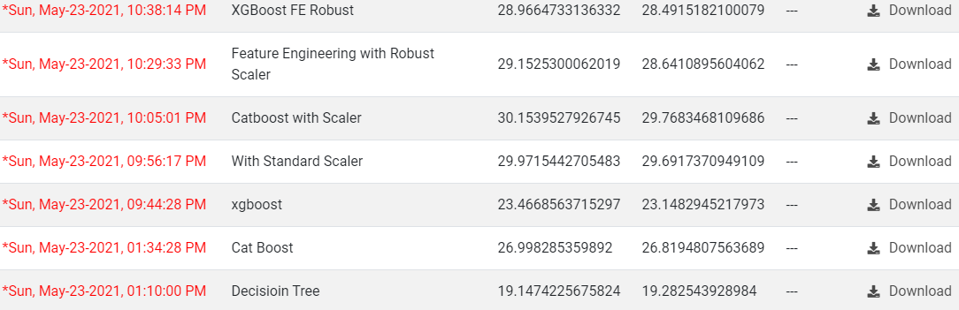
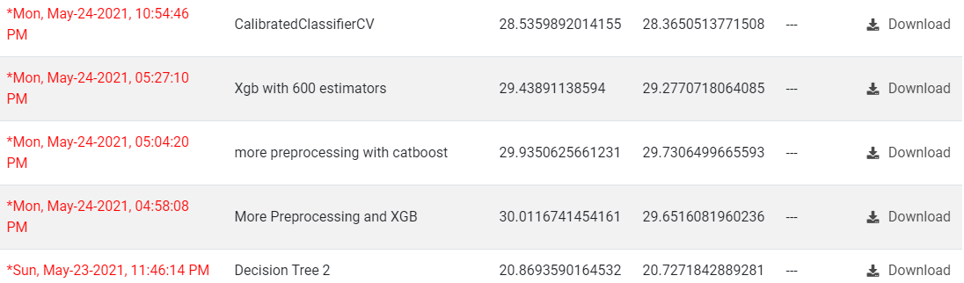
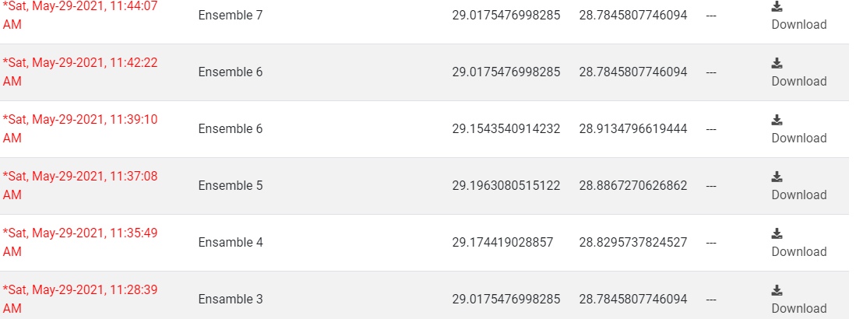
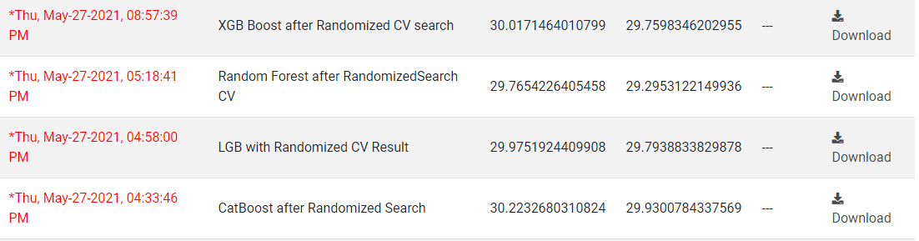
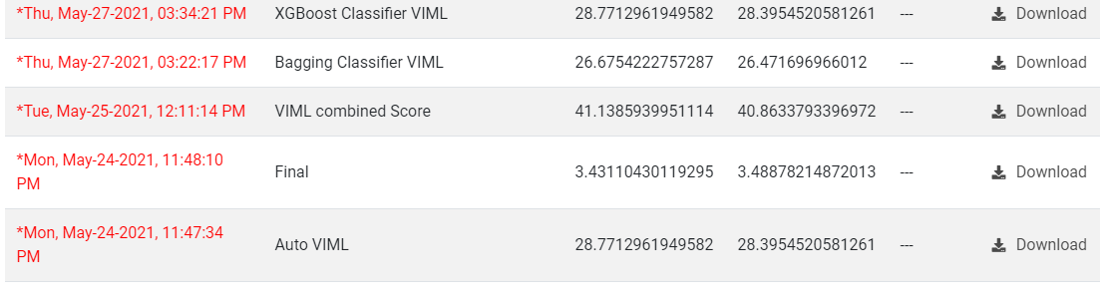
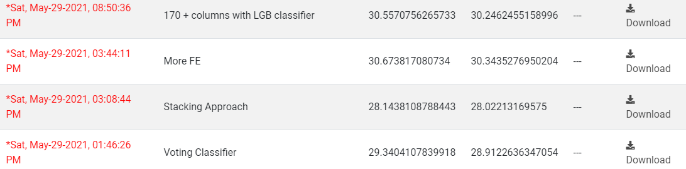
AV Performance
DAY One
DAY Two
Ensemble RF, XGB, Cat & LGB
Randomized SearchCV
Auto VIML Score
Stacking , Voting & Regressive Feature Engineering

Slide 5
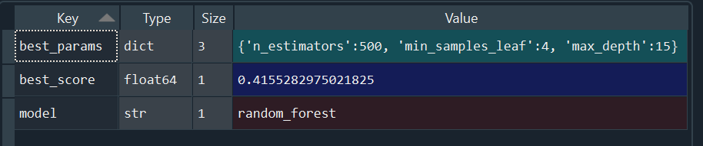
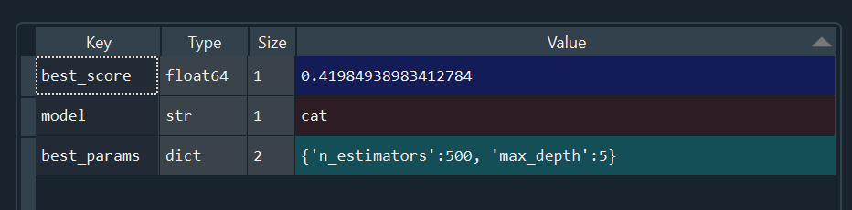
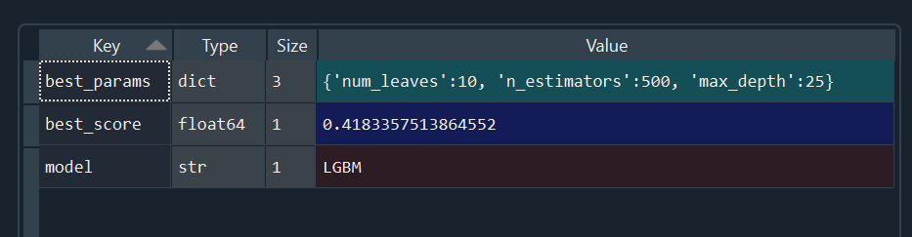
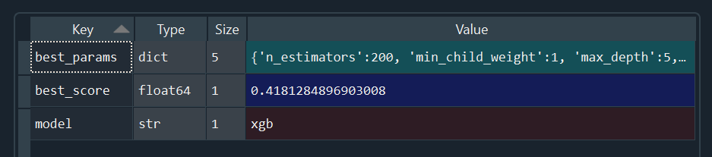
Hyper Parameter Tuning
Random Forest ----->
Cat Boost Classifier ----->
Light Gradient Boost ----->
XGBoost Classifier ----->

Slide 6
Auto_ViML
Auto_ViML was designed for building High Performance Interpretable Models with the fewest variables.
Auto_ViML is every Data Scientist's model assistant that:
Helps you with data cleaning:
Assists you with variable classification:
Performs feature reduction automatically.
Produces model performance results as graphs automatically.
Handles text, date-time, structs (lists, dictionaries), numeric, boolean, factor and categorical
Allows you to use the featuretools library to do Feature Engineering.

Slide 7
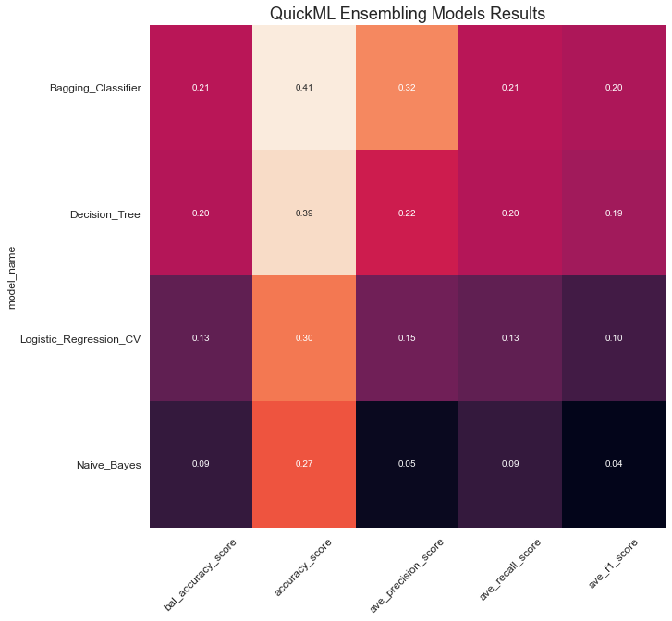
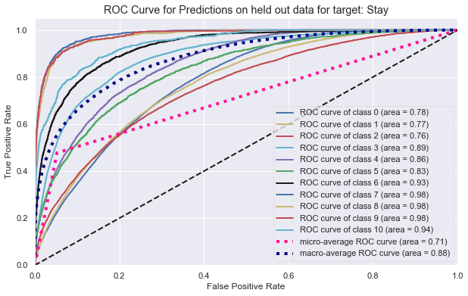
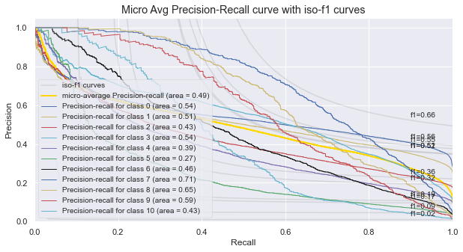
Confusion Matrix

